Slide 1






Companion
Sponsored by:
LETS PAW TOGETHER
By: Hunter Johnson, Nikki Joyner, Citlally Gomez, and Jorge Vasquez
Notes:
James

Slide 2
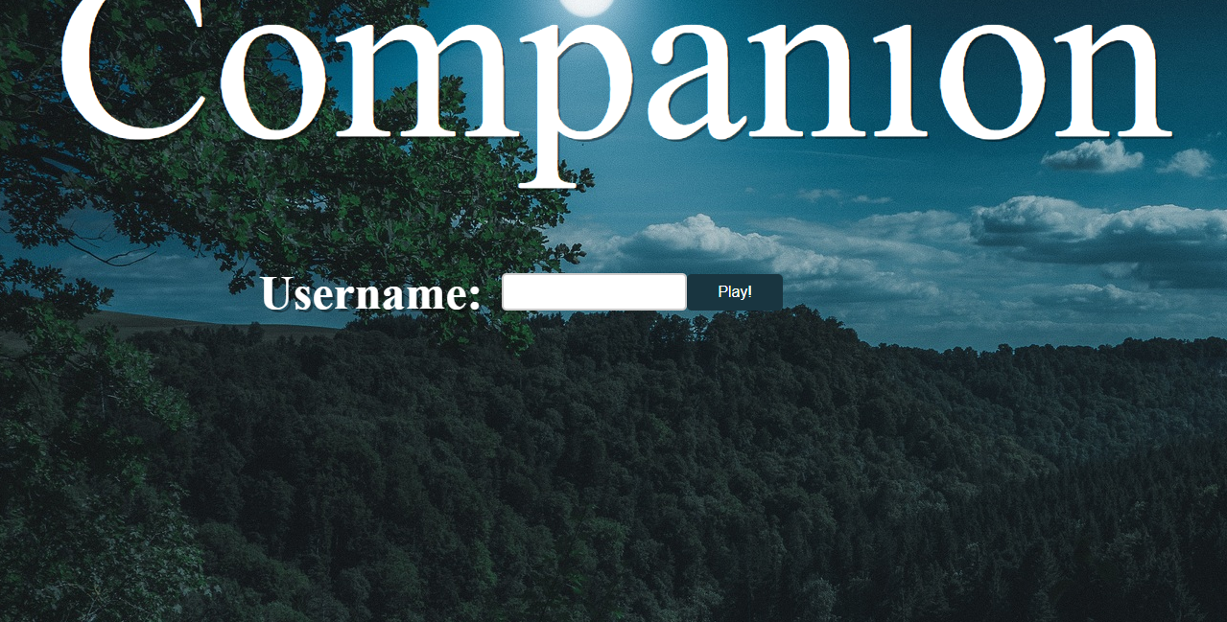
Companion: A choice-based adventure game
Notes:
hunters

Slide 3

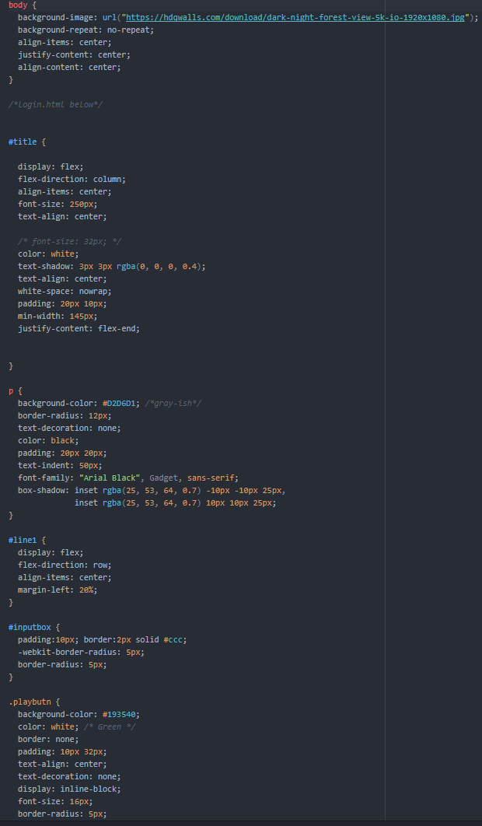
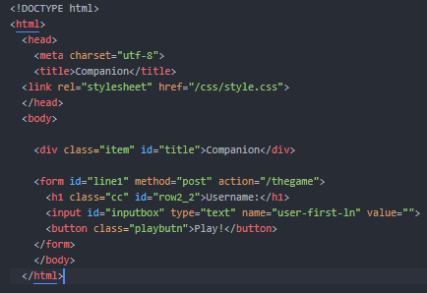
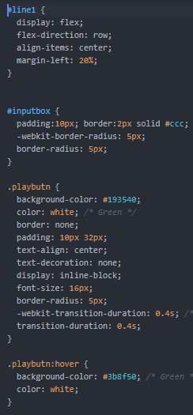
Front [Login Html and CSS]
*We modified background too prevent the image from repeating itself
#line1
Includes
-The username
-Inputbox
-playbutn
* adjusted the inputbox and the playbutn in order for it to be the same size
* The playbutnhover makes the color of the button green when hover upon
*Created title and linked the html to the style css
* Implemented a button along with the user login
Notes:
jorge

Slide 4
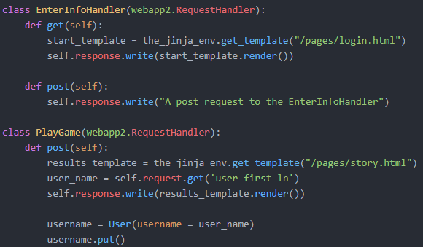
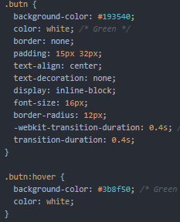
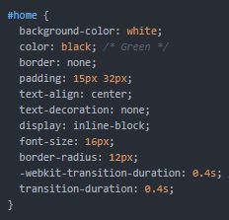
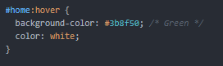
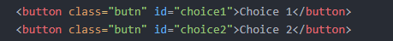
Front [CSS/main.py]
*This allows the user to enter their username
*This also helps us get the username input
* When you click the home button you go back to the home page
*The “butn” are the two options you have to chose from
Notes:
hunter

Slide 5

Challenges
Problems
Solutions
*Trying to link the JavaScript to the story html.
*Getting the username to save to a database.
*Creating an engaging and imaginative story without being repetitive.
*We put the JavaScript inside a script and inside the story html.
*Looked at past projects and how they implemented python to store variables to a database.
*Pulling constant feedback from my teammates and proofreading over multiple times.
Notes:
nikki

Slide 6

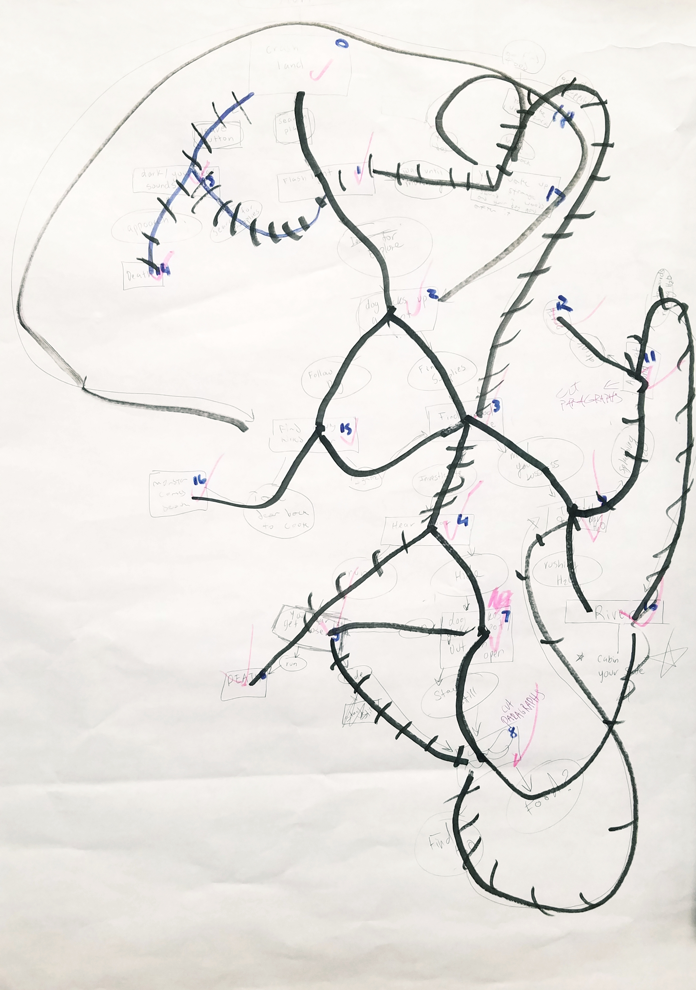
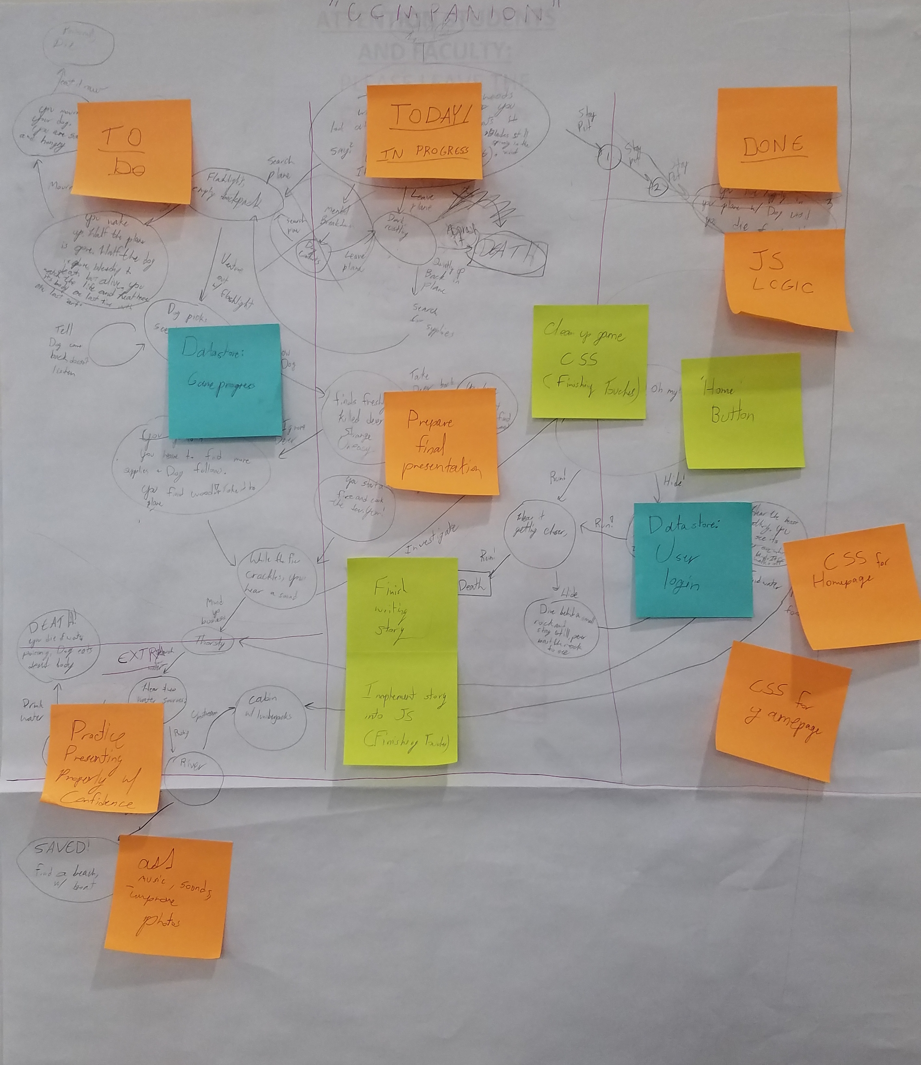
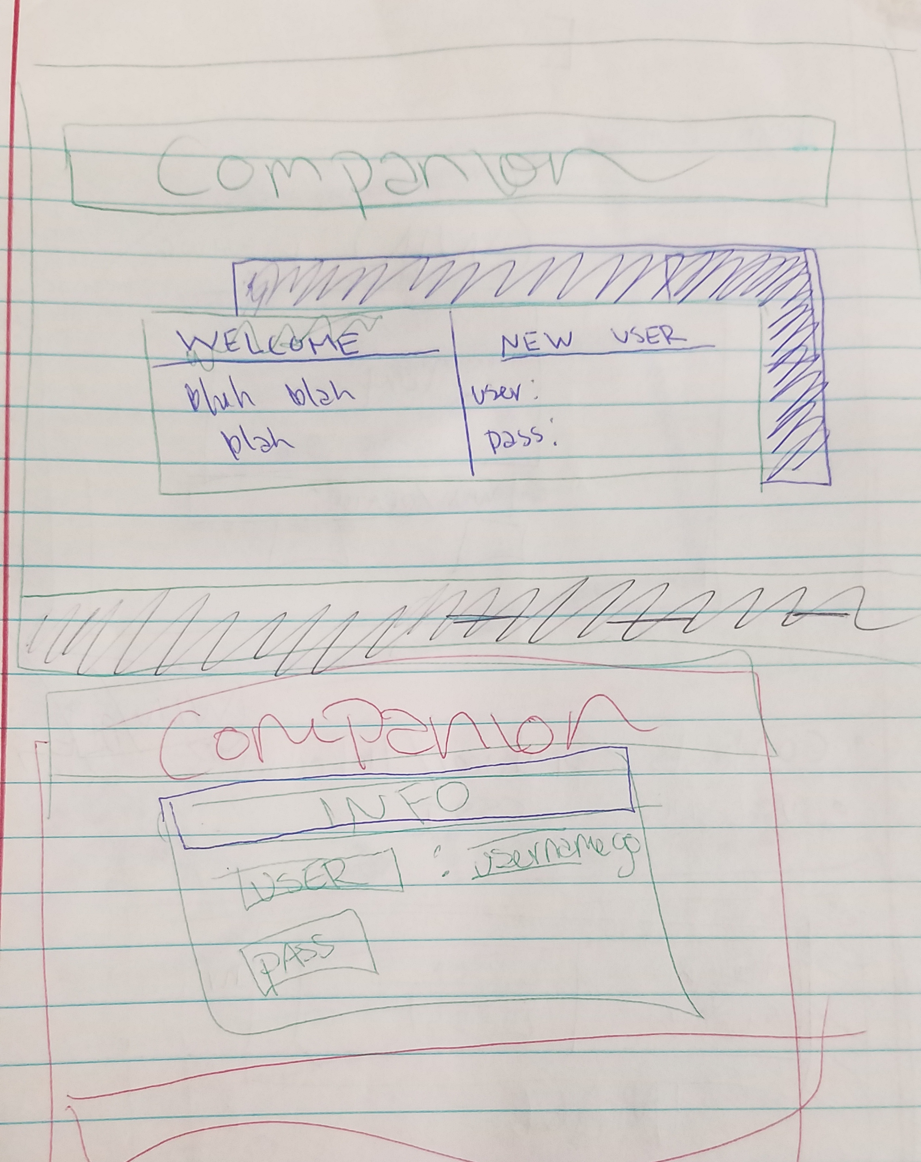
ACCOMPLISHMENTS
Planning
MAP
Format of the home page
Notes:
citlally

Slide 7


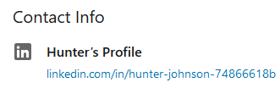
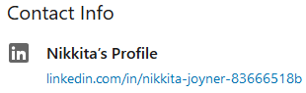
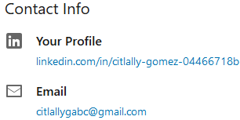
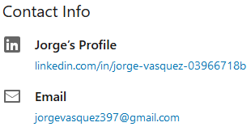
ANY QUESTIONS?
Thankyou
Hunter Johnson
Nikki Joyner
Citlally Gomez
Jorge Vasquez
Notes:
everyone

